Slide 1
Comparison between Python and C#
(for own reading)

Slide 2
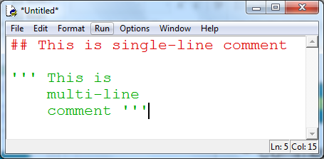

Comments
Python :
C# :

Slide 3
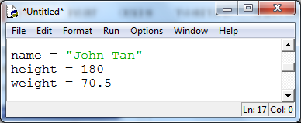

Variables
Python :
C# :
Data type must be declared and end with semicolon.
Semicolon is a statement terminator in C#.

Slide 4
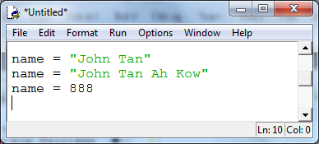

More on Variables
Python :
C# :
Data type declared only once for each variable
Can only assign value to the variable’s data type
Error!!!

Slide 5
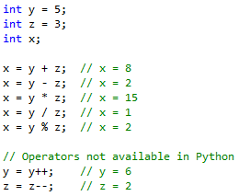
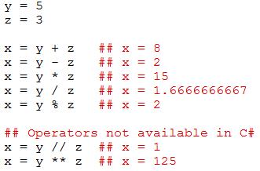
Arithmetic Operators
C# :
Python :

Slide 6
Relational Operators
Both Python and C# are the same.
Operator | Description
== | equal
!= | not equal
> | greater than
>= | greater than or equal
< | less than
<= | less than or equal

Slide 7
Logical Operators
Python | C#
and | &&
or | ||
not | !

Slide 8
Chained Relational Operators
to test whether value in a is between 1 and 10 inclusively
Python | C#
1 <= a <= 10 | Not available
a >=1 and a <= 10 | a>=1 && a <= 10

Slide 9
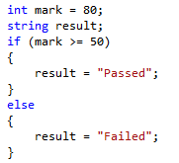

Selections
C# :
Python :

Slide 10
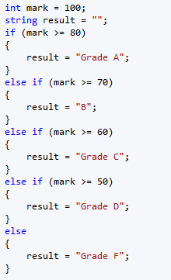
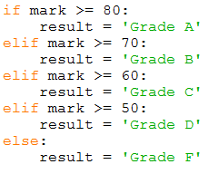
More on Selections
Python :
C# :

Slide 11
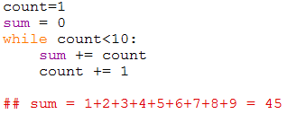
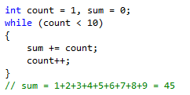
Repetitions – while
Python :
C# :

Slide 12

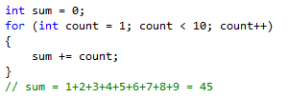
Repetitions – for
Python :
C# :

